Slide 1
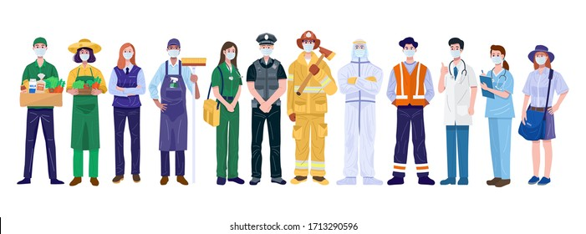
IT – B Group – 6 M.AMRUTH SAI : 1602-19-737-066 K.BHARATH : 1602-19-737-069 B.JOSEPH : 1602-19-737-074
WORK AT YOUR WILL

Slide 2
OVERVIEW
PROBLEM STATEMENT
ABSTRACT
USE CASES
TECH STACK
USE CASE DESCRIPTIONS
ARCHITECTURE
UML DIAGRAMS
DB SCHEMA

Slide 3

PROBLEM STATEMENT
We live in a world where time is of prime importance. So often we end up putting our important needs and wants on hold because we can’t find enough time from our busy schedules or find the right person to help us do that. As is the case with all the big problems, this one too has a simple and elegant solution that Work At Your Will has successfully captured and implemented.
It is basically an online directory of service providers who can be booked as per your convenience for over 60 hiring services across 5 major categories – Home, Health, Events, Lessons, and other personal services

Slide 4

OBJECTIVE
“WORK AT YOUR WILL” is a Android-based application where people who want to hire workers for their household works like Electricals , Carpentry can find a worker for the need. Here, the user who want to hire can book worker services with the workers at their own time by signing up to WORK AT YOUR WILL using their email id/mobile no.
In return the worker will verify their service requests and approves for services . Then the user needs to complete the payment and can get the service. WORK AT YOUR WILL provides affordable and reliable services for their need .

Slide 5
ABSTRACT
Our Work India application is a one-stop solution for all the recruitment needs aims at creating a system which allows a user to finish their work in a easy way and acts as a perfect job search portal for all the skill-full workers who are driven and best at providing their services considering user’s comfort as their priority.
Our application creates a collaborative environment for job seekers where all they must do is simply post their information regarding their respective job expertise on our application and the user can get to choose a cook, driver, accountant, hairdresser, sales executive, tailor, photographer etc. depending upon their needs from the available options and hire them temporarily.

Slide 6
ABSTRACT
The main objective of our application is, it allows the users to find people nearer to them and get the work done from people having knowledge with the concerned problem and provides a great user interface, where the user can easily hire people with relevant industry experience to complete their work.

Slide 7
NEW FEATURES
Interact with Worker : User can interact with worker for bargain system.
Book for a Service : User can book a Service of this requirement.
Review & Rating System : Each Worker has Review & Rating System which helps Users to know about the Service Provider.
Worker Price Prediction : Admin can predict service price by selecting attributes .
Complain Issue : User can Complain an issue directly to Worker’s Service

Slide 8


USE CASES
WORKER
Register
Login
Add Worker’s Services
USER
Register
Login
Search For Required Worker
View Customer Details
ADMIN
Register
Login
View Users and Workers
Details

Slide 9




TECH STACK
IDE: Android Studio
FRONT END: XML
BACK END:
Java
Firebase: Open platform which provided by GOOGLE

Slide 10
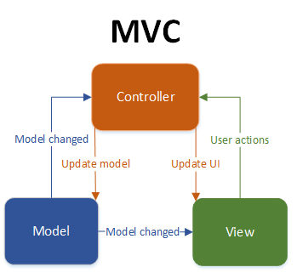
ANDROID ARCHITECTURE

Slide 11
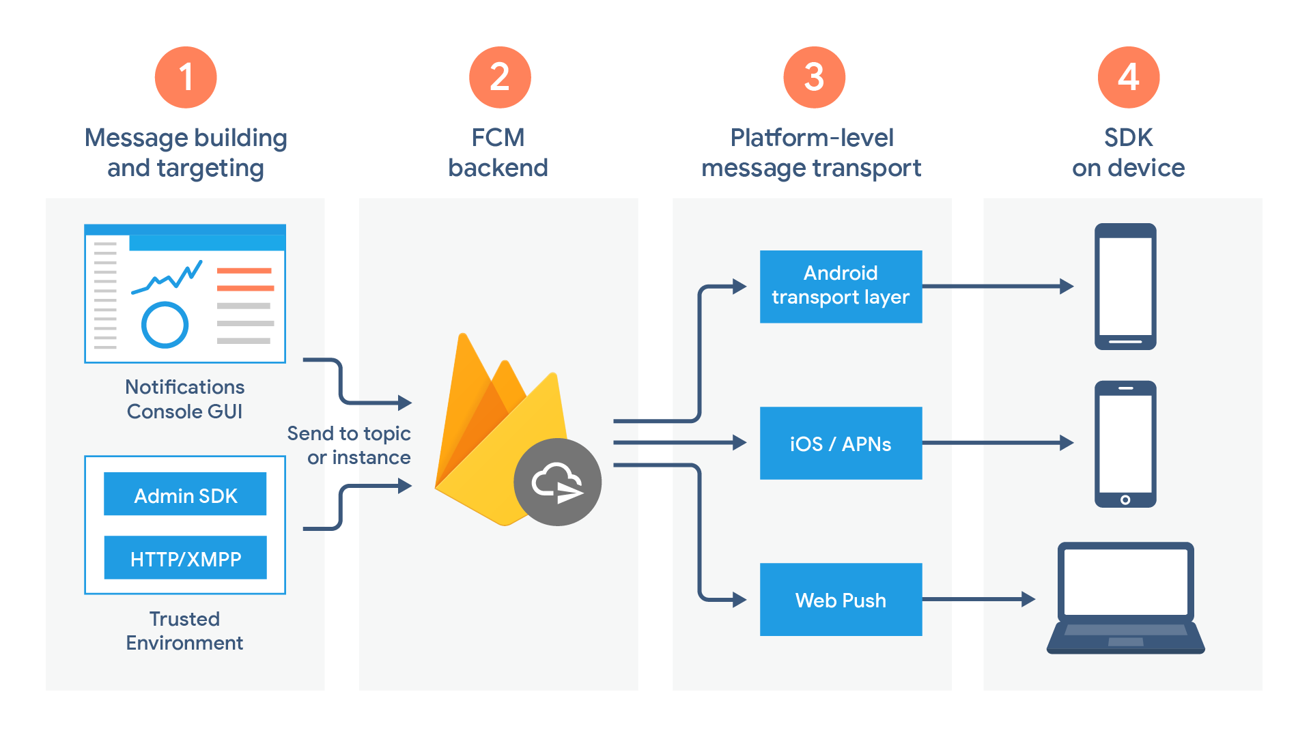
FIREBASE ARCHITECTURE

Slide 12
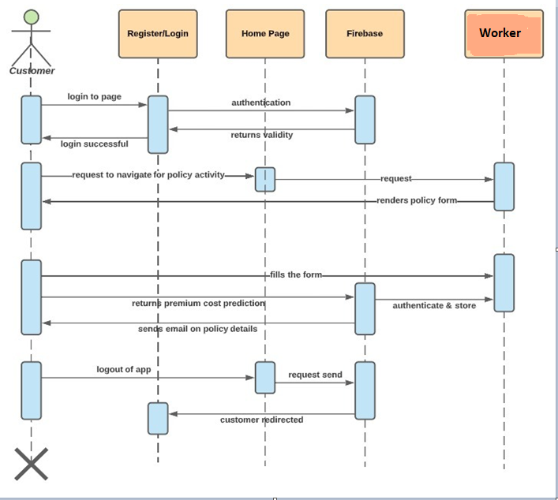
SEQUENCE DIAGRAM

Slide 13
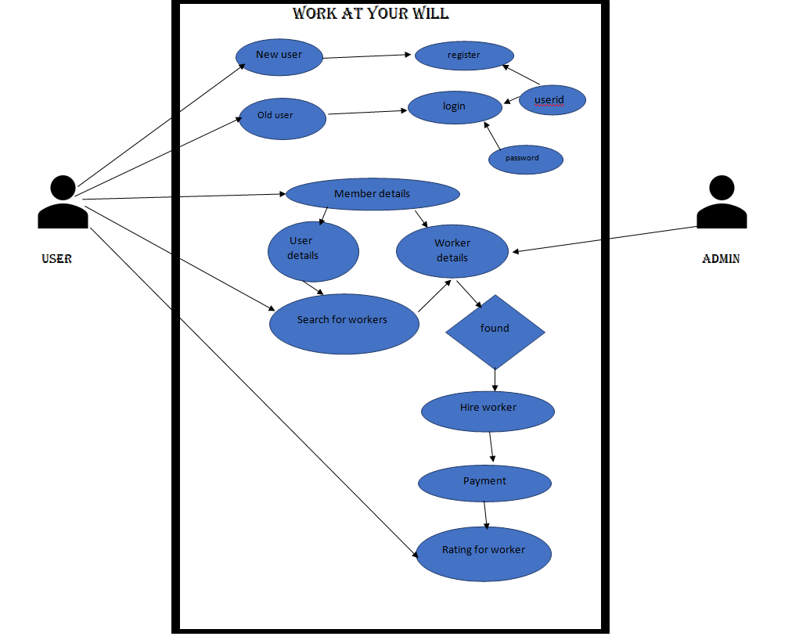
USE CASE

Slide 14

AUTHENTICATION
This use case consists of 2 sub-categories:
REGISTER
LOGIN implemented using OTP verification

Slide 15


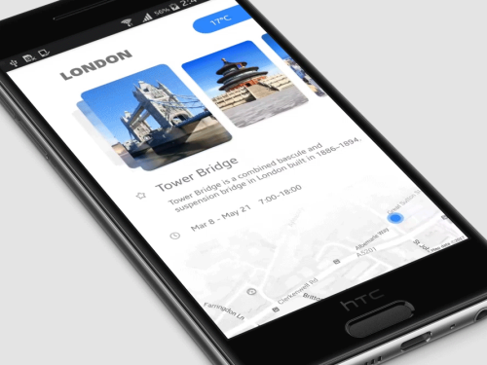

APPLY INSURANCE
1. Build ML Model
2. Create Flask API
3. Testing with POSTMAN
4. Android implementation using
Volley Library.

Slide 16
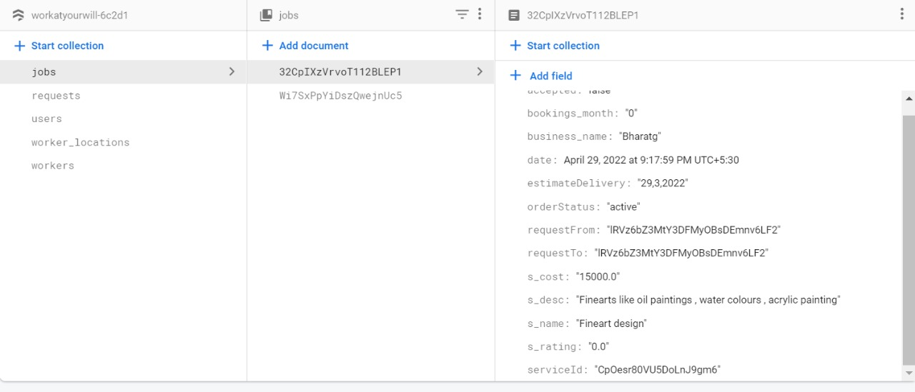
USERS NODE

Slide 17
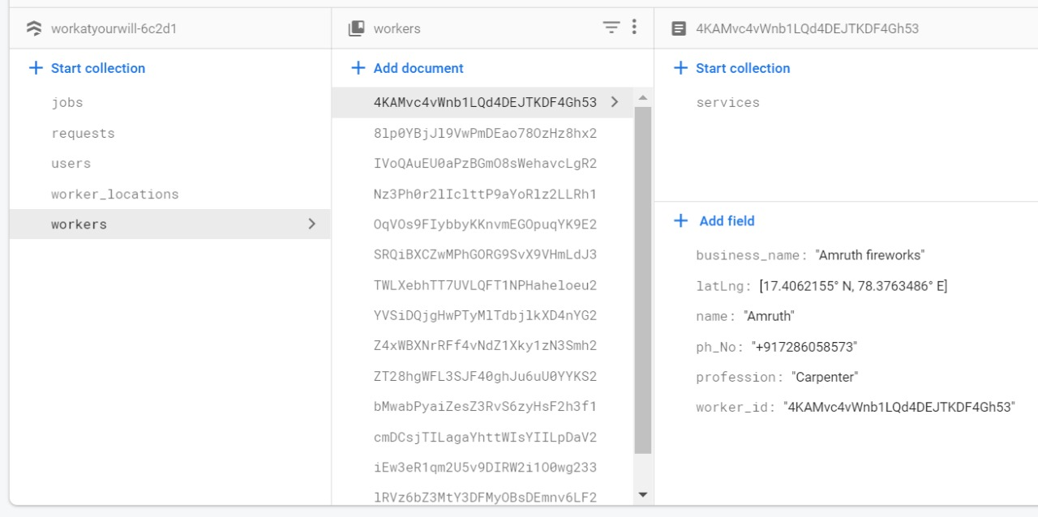
USERS NODE

Slide 18

THANK YOU FOR YOUR KIND ATTENTION

